Slide 1

Async, Await, Oh… Wait!
You’d better watch your step December 2016 – Alt.Net Paris
@tpierrain (use case driven)

Slide 2


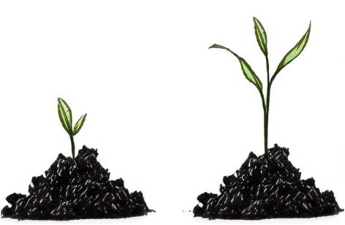

“Use Case Driven”, but also…
Reactive Programmer (> 10 years)
eXtreme Programmer (> 10 years)
Programmer (> 18 years)
NFluent
Value (DDD)
@tpierrain

Slide 3

Notes:
Ref: http://www.world-of-knives.ch/public/media/filer_thumbnails/2011/11/14/fk-140wh-wh_5_5_3.jpg__663x372_q80_crop-1_upscale-1.jpg

Slide 4
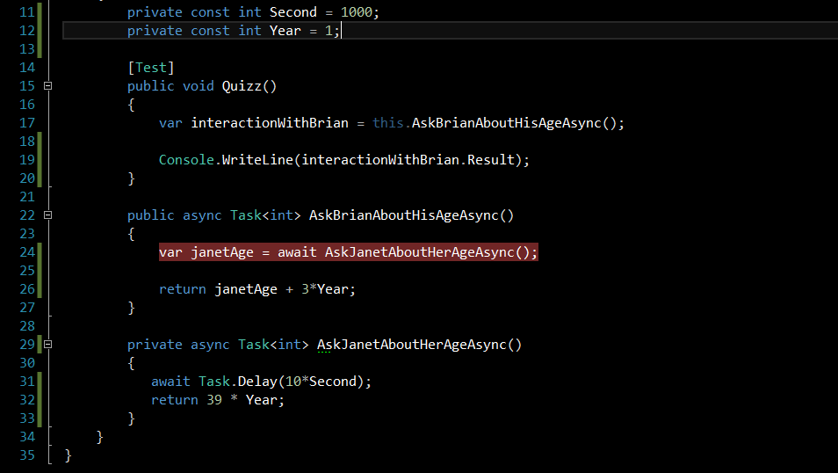
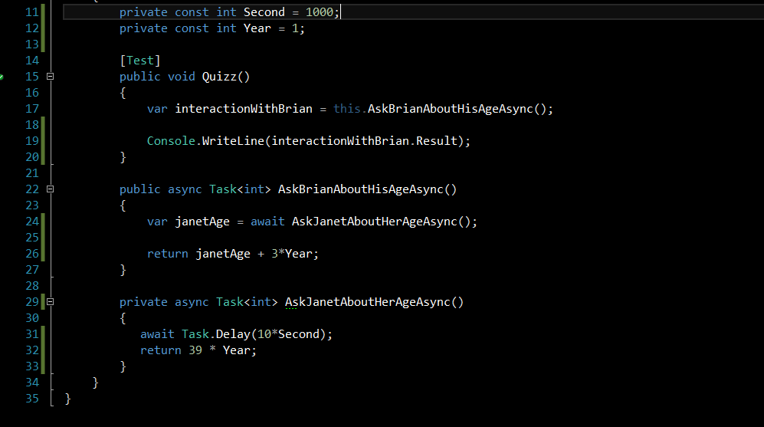
Let’s start with A question…

Slide 5
Let’s start with A question…
Q: What happens line 24, when await occurs?

Slide 6
Oups! Let’s Add some context

Slide 7
Let’s start with A question…
Q: What happens line 24, when await occurs?

Slide 8
Let’s start with A question…
Q: What happens line 24, when await occurs?

Slide 9
Let’s start with A question…
1

Slide 10
Let’s start with A question…
1

Slide 11
Let’s start with A question…
1

Slide 12
Let’s start with A question…
1

Slide 13
Let’s start with A question…
1

Slide 14
Let’s start with A question…
1

Slide 15
Let’s start with A question…
1

Slide 16

Let’s start with A question…
1
2

Slide 17
Let’s start with A question…
1
2

Slide 18
Let’s start with A question…
1
2

Slide 19
Let’s start with A question…
1
2

Slide 20
Let’s start with A question…
1
2

Slide 21
Let’s start with A question…
1
2

Slide 22
Let’s start with A question…
1

Slide 23
Let’s start with A question…
1
2

Slide 24
Let’s start with A question…
1
2

Slide 25
Let’s start with A question…
1
2

Slide 26
Let’s start with A question…
1
2

Slide 27
Let’s start with A question…
1
2

Slide 28
Let’s start with A question…
2
1

Slide 29
Let’s start with A question…
2
1
1

Slide 30
Let’s start with A question…
1

Slide 31
Let’s start with A question…
1

Slide 32

Was IT your first answer?
Replay?
Notes:
Ref: http://images.martechadvisor.com/images/uploads/content_images/cbc928ab5eb5e7f00676992442650b40.jpg

Slide 33

Guess what…
Same code in ASP.NET or UI Context
will deadlock!
Notes:
Ref:http://i.imgur.com/ZnREN.jpg

Slide 34
Oh… Wait! Agenda
Why
What
How
Pitfalls & Recommendations

Slide 35
Chapter 1: Why

Slide 36

Like me, You don’t like Waste?
Notes:
Ref: http://blog.canacad.ac.jp/wpmu/15matser/files/2013/06/FoodWaste1.jpg

Slide 37

A simple rule to avoid waste of CPU

Slide 38
Async-await intention is...
…To easily transform
synchronous code ➔ asynchronous code
(Without hurting your existing code structure)

Slide 39

Without hurting your existing code structure
Notes:
Ref : http://www.careofcars.com/wp-content/uploads/2014/01/patchwork-on-cheap-cars.jpg

Slide 40

Wait a minute… Asynchronous, Concurrent, Parallel?
Notes:
Ref: http://ci.memecdn.com/7869512.jpg

Slide 41


synchronous
Asynchronous
Perform something here and now.
The caller thread will be blocked until it’s done
Initiate something here and now (off-loading).
The caller thread is released immediately
Free for something else
No waste of CPU resource ;-)
Notes:
Refs :
- https://cdn3.iconfinder.com/data/icons/basic-mobile-part-3/512/prisoner-512.png
- https://cdn4.iconfinder.com/data/icons/human-values-solid/100/_-62-512.png
- https://d30y9cdsu7xlg0.cloudfront.net/png/89995-200.png

Slide 42
synchronous
Asynchronous
Perform
Initiate
This is about invocation! (not about how the Goddamn thing is executed)
Notes:
Refs :
- https://cdn3.iconfinder.com/data/icons/basic-mobile-part-3/512/prisoner-512.png
- https://cdn4.iconfinder.com/data/icons/human-values-solid/100/_-62-512.png
- https://d30y9cdsu7xlg0.cloudfront.net/png/89995-200.png

Slide 43
What about execution

Slide 44
Concurrency
Multiple “threads” of execution
Independent logical segments
Notes:
Not OS threads
e.g.:
JavaScript in a browser
Node.js
e.g.:
Thread-based (e.g. multi-threading)
Task-based (e.g. TPL)

Slide 45
Concurrency
Parallelism
Multiple “threads” of execution
Independent logical segments
Concurrency + Simultaneous execution
Notes:
Not OS threads
e.g.:
JavaScript in a browser
Node.js
e.g.:
Thread-based (e.g. multi-threading)
Task-based (e.g. TPL)

Slide 46
Concurrency
Parallelism
Multiple “threads” of execution
Independent logical segments
Concurrency + Simultaneous execution
This is about Execution! (of the Goddamn thing ;-)
Notes:
Not OS threads
e.g.:
JavaScript in a browser
Node.js
e.g.:
Thread-based (e.g. multi-threading)
Task-based (e.g. TPL)

Slide 47
Chapter 2: What

Slide 48
Async-Await is Not About Going Async

Slide 49
Async-Await is About Composing the Async

Slide 50
Composing the Async
With Task continuations
Notes:
Refs :
- https://cdn3.iconfinder.com/data/icons/basic-mobile-part-3/512/prisoner-512.png
- https://d30y9cdsu7xlg0.cloudfront.net/png/89995-200.png

Slide 51
Chapter 3: How

Slide 52
(Prerequisite - TPL)

Slide 53
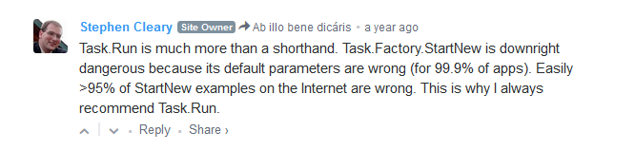
Task Parallel Library reminder (TPL)
3 ways to instantiate and run a TASK:
var task = Task.Run(lambda);
var task = new Task(lambda).Start();
Task.Factory.StartNew(lambda);
task.Wait(), task.Result & task.Exception ( all blocking ;-(

Slide 54
Task Parallel Library reminder (TPL)
Continuation
A Task that will be achieve once a previous Task has finished
var continuationTask = previousTask.ContinueWith(lambda);
PreviousTask
ContinuationTask

Slide 55
Async-Await

Slide 56
Async-Await

Slide 57
Async
GENERATES STATE MACHINE

Slide 58
Await
Marks a continuation

Slide 59
Async

Slide 60
Async
GENERATES STATE MACHINE

Slide 61
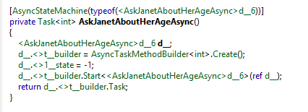
Async
GENERATES STATE MACHINE
At Compile time

Slide 62
Async
GENERATES STATE MACHINE
At Compile time

Slide 63
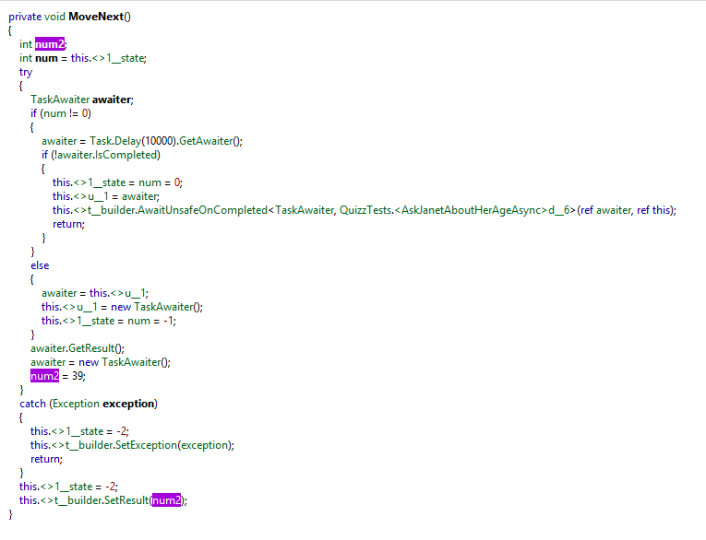
Async
GENERATES STATE MACHINE
At Compile time

Slide 64
Await

Slide 65
Await
Marks a continuation

Slide 66
Await
Returns to the caller with a Continuation task

Slide 67
Who’s doing the continuation?
Well… it depends ;-)

Slide 68
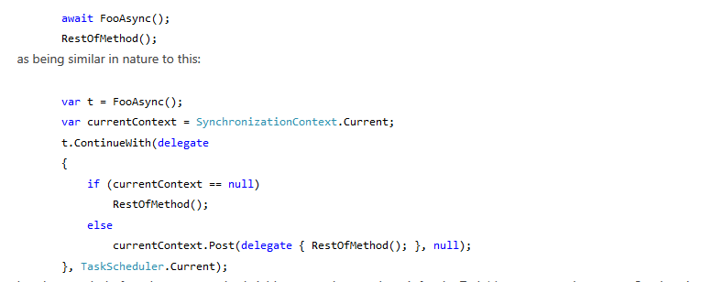
It depends on the awaiter context
The following code:
Is equivalent to:
WinForms,
WPF,
ASP.NET…

Slide 69
Async-Await
GENERATES STATE MACHINE
Marks a continuation

Slide 70
Thread(s) or no thread?

Slide 71

Windows I/O: under the hood
Notes:
Ref: https://static1.squarespace.com/static/544d2af6e4b007f43083a5b0/544e719be4b07c493b25c4e4/54625440e4b0f79db69b3b1a/1417724183061/?format=1500w

Slide 72
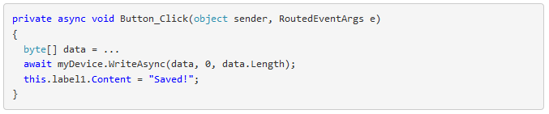
Windows I/O: under the hood

Slide 73
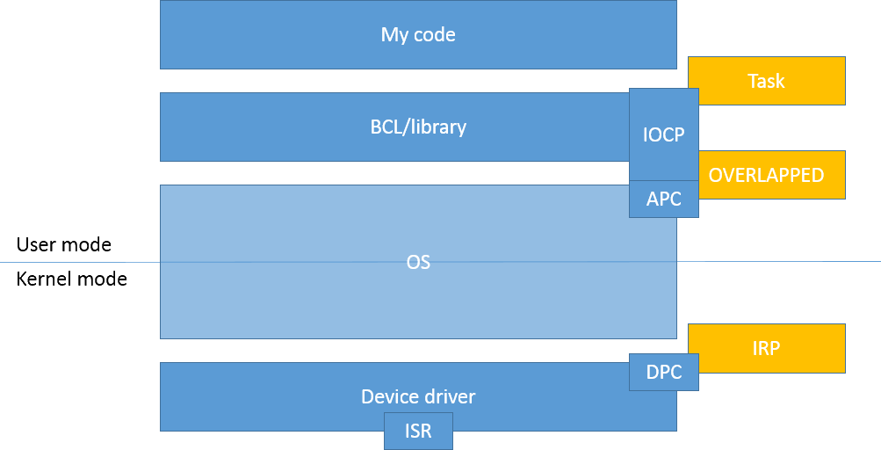
Windows I/O: under the hood
User mode
Kernel mode

Slide 74
Windows I/O: under the hood
UI thread
User mode
Kernel mode
Thread

Slide 75
Windows I/O: under the hood
BCL.WriteAsync()
User mode
Kernel mode
Thread

Slide 76
Windows I/O: under the hood
P/Invoke handle
User mode
Kernel mode
Thread

Slide 77
Windows I/O: under the hood
User mode
Kernel mode
Create I/O Request Packet (IRP)
(asynchronous)
Thread

Slide 78
Windows I/O: under the hood
Return Task (await)
User mode
Kernel mode
Thread

Slide 79
Windows I/O: under the hood
Release UI thread
User mode
Kernel mode
Thread

Slide 80

Windows I/O: under the hood
User mode
Kernel mode
NO Thread

Slide 81
Windows I/O: under the hood
User mode
Kernel mode
Interrupt!
NO Thread

Slide 82

Windows I/O: under the hood
User mode
Kernel mode
Interrupt Service Routine (ISR)
NO Thread

Slide 83
Windows I/O: under the hood
User mode
Kernel mode
Queue
Deferred Procedure Call (DPC).
NO Thread

Slide 84
Windows I/O: under the hood
User mode
Kernel mode
Mark IRP
as completed
NO Thread

Slide 85
Windows I/O: under the hood
Create Asynchronous Procedure Call (APC)
to notify the UI process (handle)
User mode
Kernel mode
NO Thread

Slide 86
Windows I/O: under the hood
Execute
APC via I/O Completion port (IOCP) thread
User mode
Kernel mode
Thread

Slide 87
Windows I/O: under the hood
Execute
APC via I/O Completion port (IOCP) thread
User mode
Kernel mode
Thread

Slide 88
Windows I/O: under the hood
Post the continuation for UI thread execution
User mode
Kernel mode
Thread

Slide 89
Windows I/O: under the hood
User mode
Kernel mode

Slide 90
Windows I/O: under the hood
Execute continuation (UI thread)
User mode
Kernel mode
Thread

Slide 91
Windows I/O: under the hood
Execute continuation (UI thread)
User mode
Kernel mode
Thread

Slide 92

Windows I/O: under the hood
User mode
Kernel mode

Slide 93
Chapter 4: Pitfalls & Recos

Slide 94
#1: Deadlock

Slide 95
Initial Question, but in a GUI context
1

Slide 96
Initial Question, but in a GUI context
1

Slide 97
Initial Question, but in a GUI context
1

Slide 98
Initial Question, but in a GUI context
1

Slide 99
Initial Question, but in a GUI context
1

Slide 100
Initial Question, but in a GUI context
1

Slide 101
Initial Question, but in a GUI context
1

Slide 102
Initial Question, but in a GUI context
1
2

Slide 103
Initial Question, but in a GUI context
1
2

Slide 104
Initial Question, but in a GUI context
1
2

Slide 105
Initial Question, but in a GUI context
1
2

Slide 106
Initial Question, but in a GUI context
1
2

Slide 107
Initial Question, but in a GUI context
1
2

Slide 108
Initial Question, but in a GUI context
1

Slide 109
Initial Question, but in a GUI context
1
2

Slide 110
Initial Question, but in a GUI context
1
x
The GUI case

Slide 111

Initial Question, but in a GUI context
1
x

Slide 112

Notes:
Ref: http://www.designnation.de/Media/Galerie/50cf9c1d197e0,Houston-we-have-a-problem.jpg

Slide 113
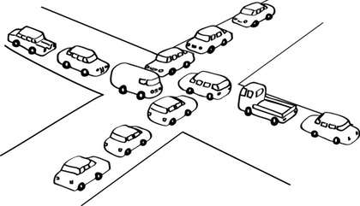
Deadlocks

Slide 114

The dupdob principle
“Qui dit lockS… dit deadlocks”
“whoever locks… eventually deadlocks”
@cyrdup
Notes:
Ref: https://avatars1.githubusercontent.com/u/3131866?v=3&s=460

Slide 115
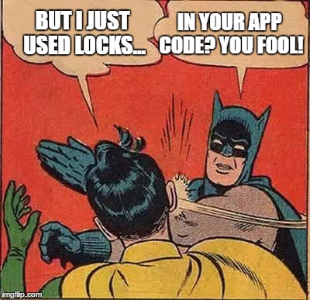
Deadlock Meme
Notes:
Ref: http://ci.memecdn.com/7869512.jpg

Slide 116
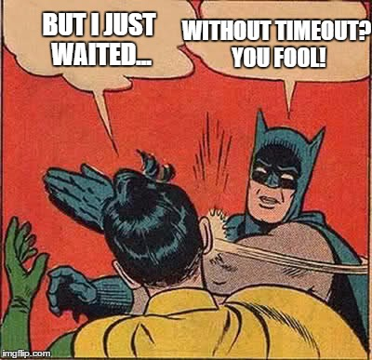
Deadlock Meme
Notes:
Ref: http://ci.memecdn.com/7869512.jpg

Slide 117
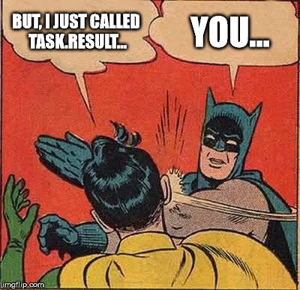
Deadlock Meme
Notes:
Ref: http://ci.memecdn.com/7869512.jpg

Slide 118
Do not block to avoid Deadlock

Slide 119
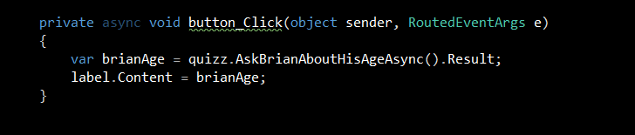
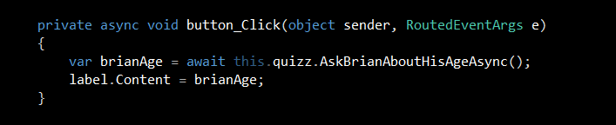
Do not block to avoid Deadlock
« await » don’t block the UI thread

Slide 120
#2: Enter the Async void

Slide 121
The Async void case
Async void is a “fire-and-forget” mechanism...
The caller is unable to know when an async void has finished
The caller is unable to catch exceptions thrown from an async void
(instead they get posted to the UI message-loop)
TADA!

Slide 122
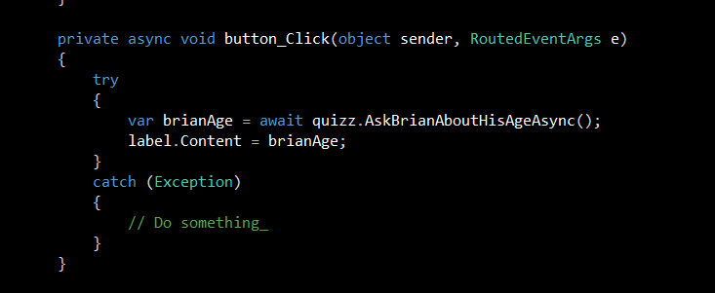
Try-catch your event handlers!

Slide 123
MS Guidelines
Use async void methods only for top-level event handlers (and their like)
Use async Task-returning methods everywhere else
Try-Catch your Async event handlers!

Slide 124
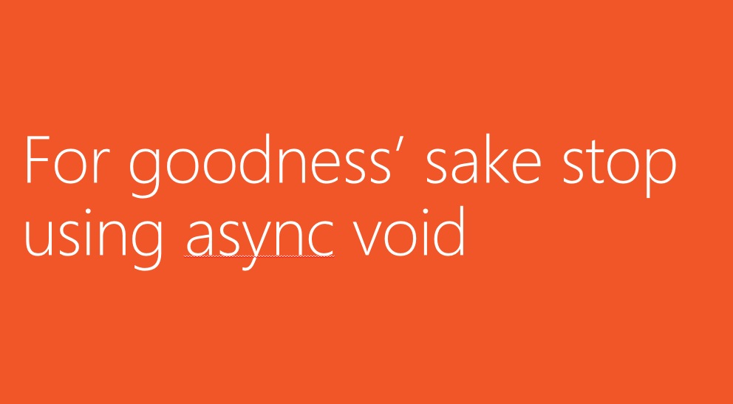
MS even said:

Slide 125
#3: Use It wisely

Slide 126
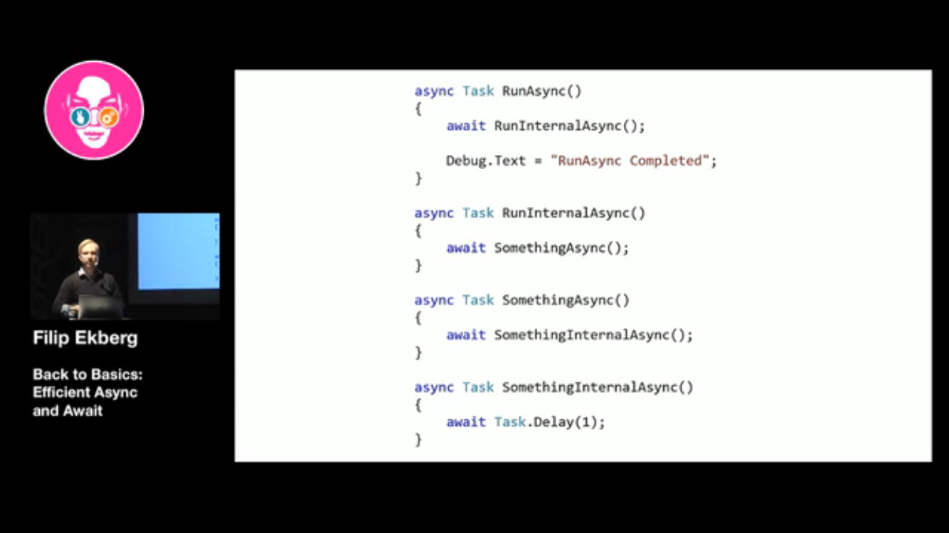

Don’t systematize Async-await!
Nothing in the continuation?
No need for await!

Slide 127
Wrap-up

Slide 128

Wrap-up
Never block! Unless you want to deadlock
Locks, Wait without timeout, Task.Result… ;-(
Use top-level await when coding UI or Web
Never create « async void » methods
And try catch all such existing event handlers
Nothing in the continuation? No need for await!
Avoid declaring async if not needed -> return Task instead
Don’t use Async-Await
unless you understand how it works

Slide 129
Thanks!

Slide 130
Appendix

Slide 131
Async method GC impact
3 allocations for every Async method
Heap-allocated state machine
With a field for every local variable in your method
Completion delegate
Task

Slide 132
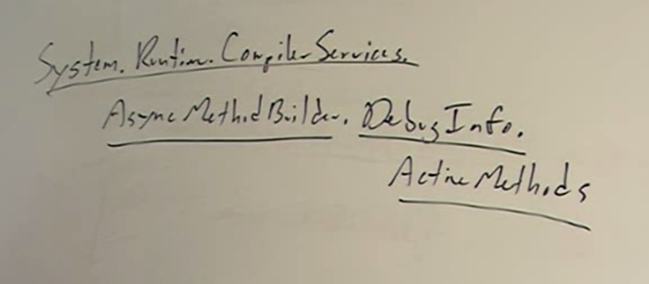
Troubleshooting?
Namespace
public type
nested type
static method

Slide 133
Few refs
Async-Await Best practices: https://msdn.microsoft.com/en-us/magazine/jj991977.aspx
Compiler error: http://stackoverflow.com/questions/12115168/why-does-this-async-await-code-generate-not-all-code-paths-return-a-value
Task.Run etiquette: http://blog.stephencleary.com/2013/11/taskrun-etiquette-examples-dont-use.html
There is no thread: http://blog.stephencleary.com/2013/11/there-is-no-thread.html
Does using Tasks (TPL) library make an application multithreaded? : http://stackoverflow.com/questions/23833255/does-using-tasks-tpl-library-make-an-application-multithreaded
Async-Await best practices: https://msdn.microsoft.com/en-us/magazine/jj991977.aspx

